Slide 1
Log4j
Crisis
Critical Vulnerability Exposed in Widely Used Library

Slide 2
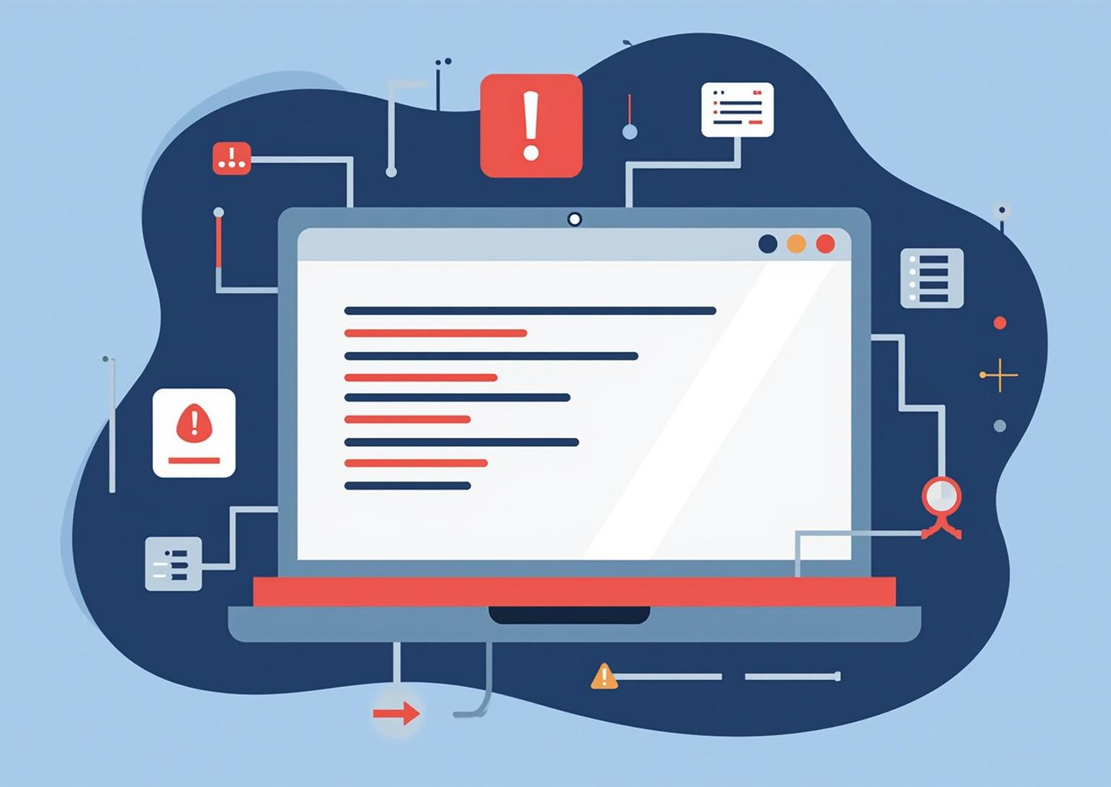
Introduction
The Log4j vulnerability represents a significant security breach within one of the most popular Java logging frameworks. This presentation explores the event timeline, the exploited weaknesses, and the broader impact while identifying the nature of the threat actors and the necessary security principles violated.

Slide 3
01
Log4j Incident Overview

Slide 4
Incident details and timeline
In December 2021, a critical remote code execution vulnerability (CVE-2021-44228) was discovered in Log4j, affecting millions of Java applications worldwide. The flaw allowed attackers to execute arbitrary code by logging specially crafted messages. Immediate widespread exploitation followed, prompting emergency patches and global security alerts.

Slide 5
Exploited vulnerabilities explained
The primary weakness exploited was improper input validation in Log4j’s JNDI lookup feature. Attackers sent malicious payloads that forced the system to fetch and execute harmful code from attacker-controlled servers. This vulnerability bypassed usual security controls due to the lack of authentication and dynamic code loading capability inherent in the logging mechanism.

Slide 6

Actors and attack methods
The Log4j vulnerability was exploited by a wide range of threat actors, including juvenile hackers, cybercriminals, and potentially terrorist groups. Attacks primarily involved sending crafted log messages to trigger remote code execution. Methods leveraged moderate sophistication, exploiting the lack of authentication in the logging framework to gain unauthorized access and execute malicious code remotely.

Slide 7

02
Consequences and Mitigation

Slide 8
Damage, losses, and security violations
The Log4j breach resulted in extensive financial and reputational damage for affected organizations. The incident compromised confidentiality, integrity, and availability of systems by allowing attackers to inject malware and disrupt services. Costs included remediation, incident response, and potential legal penalties, highlighting the critical nature of this vulnerability.

Slide 9
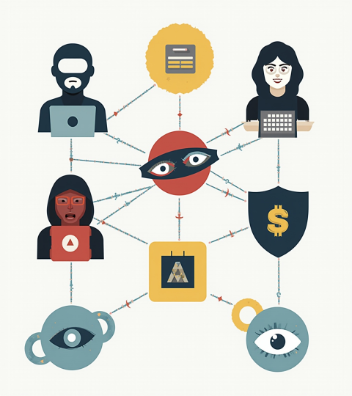
Threat sophistication and motivations
Threat actors ranged from low to moderate sophistication, often motivated by financial gain, espionage, or disruption. Cybercriminals aimed for extortion via ransomware or data theft, while some actors exploited the flaw opportunistically. Attack complexity was amplified by the broad use of Log4j in enterprise applications, increasing the attack surface significantly.

Slide 10
Risk mitigation and countermeasures
Effective mitigation includes immediate patching and updates to secure Log4j versions. Implementing strong authentication mechanisms and encryption reduces risk. Additionally, network segmentation, monitoring for suspicious activity, and physical security controls are vital to prevent exploitation and limit damage from future vulnerabilities.

Slide 11

Conclusions
The Log4j incident underscores the importance of proactive security in software development and infrastructure management. Addressing vulnerabilities through timely patches, enhancing authentication, and increasing threat awareness can significantly reduce exposure. Organizations must prioritize comprehensive risk management to protect against evolving cyber threats and preserve system confidentiality, integrity, and availability.

Slide 12
Thanks!
Do you have any questions?
youremail@freepik.com
+34 654 321 432
yourwebsite.com
Please keep this slide for attribution

